Slide 1
DB & BD: NBA dataset
Brought to you by:
Marc Violides

Slide 2

The Dataset
6 tables:
Players: around 2000
Teams: 31 total
Games: from 2004 to now
Ranking: End of Season Standings
Belongs: which team does a player belong to
Details: Player details in a game

Slide 3
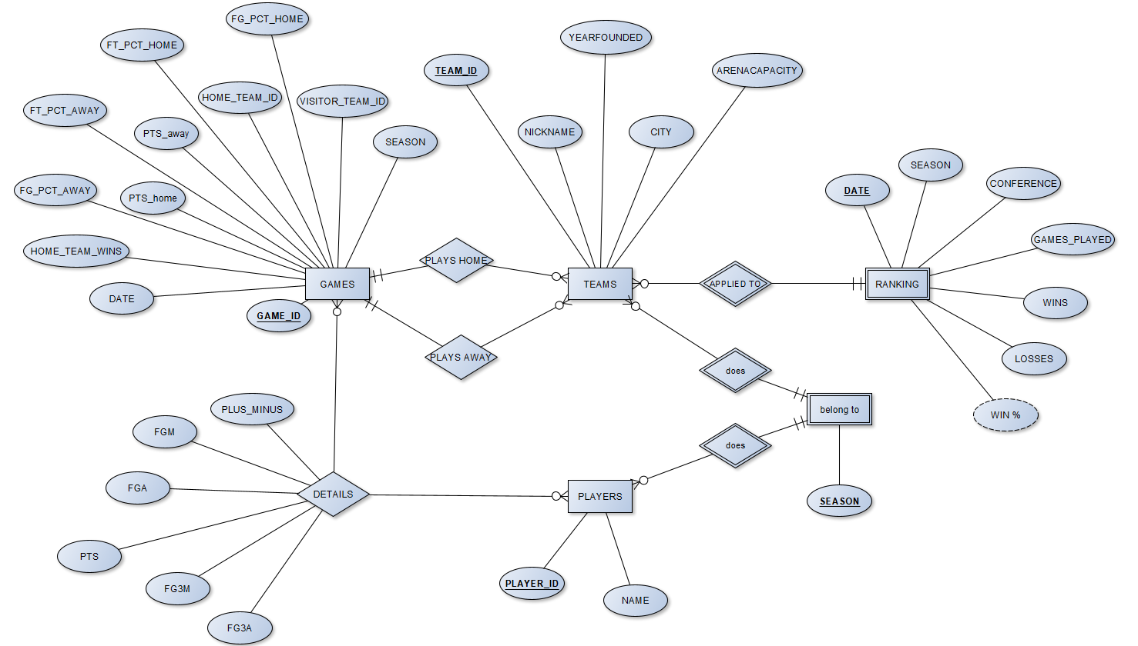
ER Diagram

Slide 4
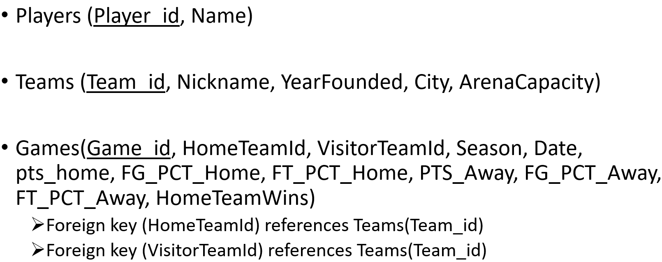
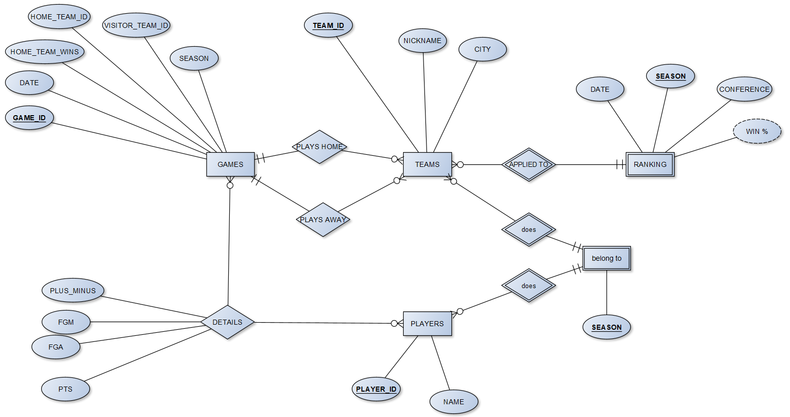
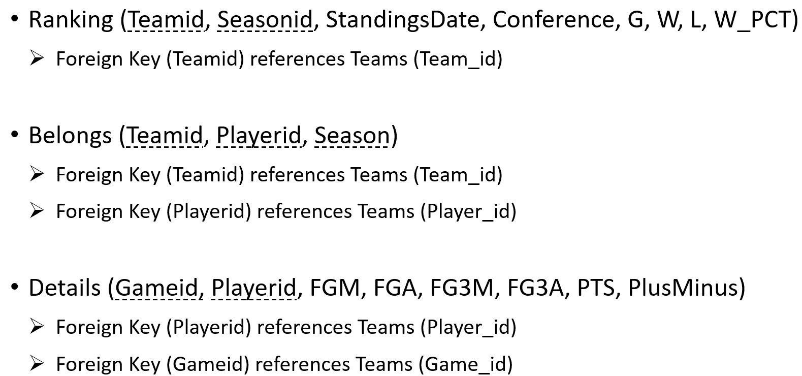
From ER To Logical Design

Slide 5
Now the interesting part... The Queries
The GOAT
Luck Or Skill?
Fans As The Sixth Player
Snakes: All-time betrayals
Geographical Crack

Slide 6

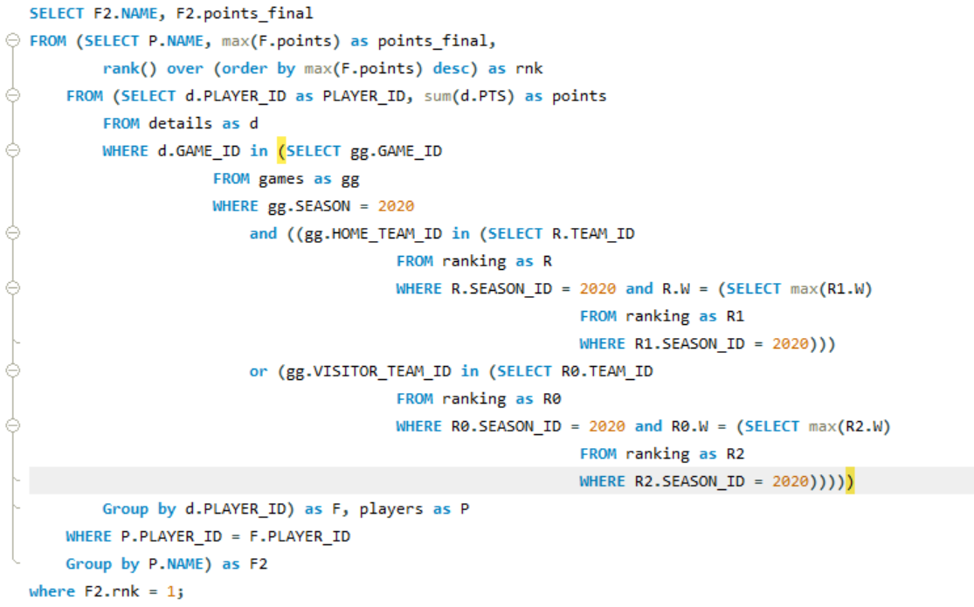

The GOAT: A sneak peak at the code + results

Slide 7
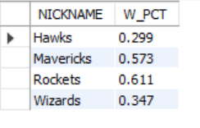
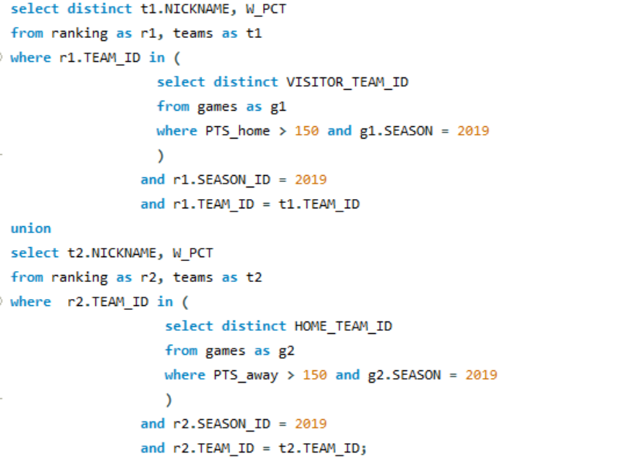

Luck Or Skill?

Slide 8


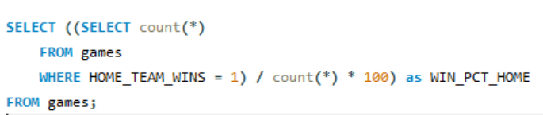

Fans as the Sixth Player

Slide 9
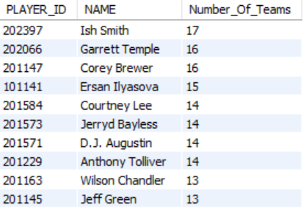


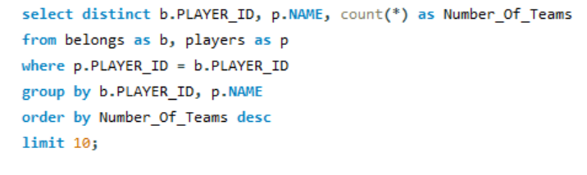
Snakes: All-time Betrayals

Slide 10


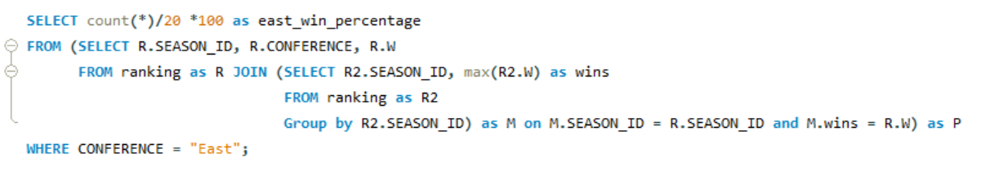
Geographical Crack: East VS West

Slide 11

The Court Is Yours
Questions?

